Slide 1
On-Device Custom AI User Experience Profiling
AI Learning User
Profile Settings
Carrier Tools periodically stores meta-data config file at server
T-Mobile
Carrier Tool Servers
App tray configuration
Sort Option for App Tray
Home screen configuration
Home Screen Grid (4x4)
Stores preferred and exact config and layout
Brightness Setting
Folder Grid (4x4)
OEM Factory Preloading Carrier Tools
OOBE
On Device Carrier Tools Client
starts AI Device UX Profile “Learning” Mode
Carrier Tools checks for prior meta data file of customer from T-Mobile Servers
When found, Carrier Tools On-Device Client engages user to restore Device UX profile
Sound level Setting
Any Home Screen or App Tray Setting Retained / Restored
Font size / Magnification Setting
Preferred AI Tool
Starts AI Device UX Profile “Learning” Mode
Notification Prefs Per App
Battery Optimizations
Re-create/grid place folders
Wallpaper/Lock Screen, etc
Ensure all apps are up-to-date from Store
Bill McCracken © 2025

Slide 2
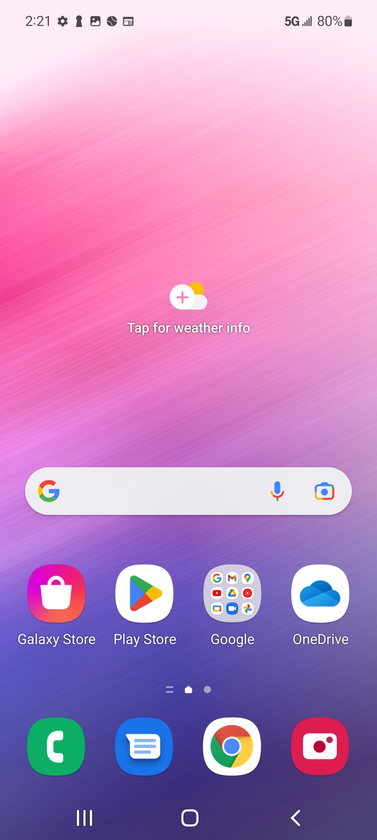
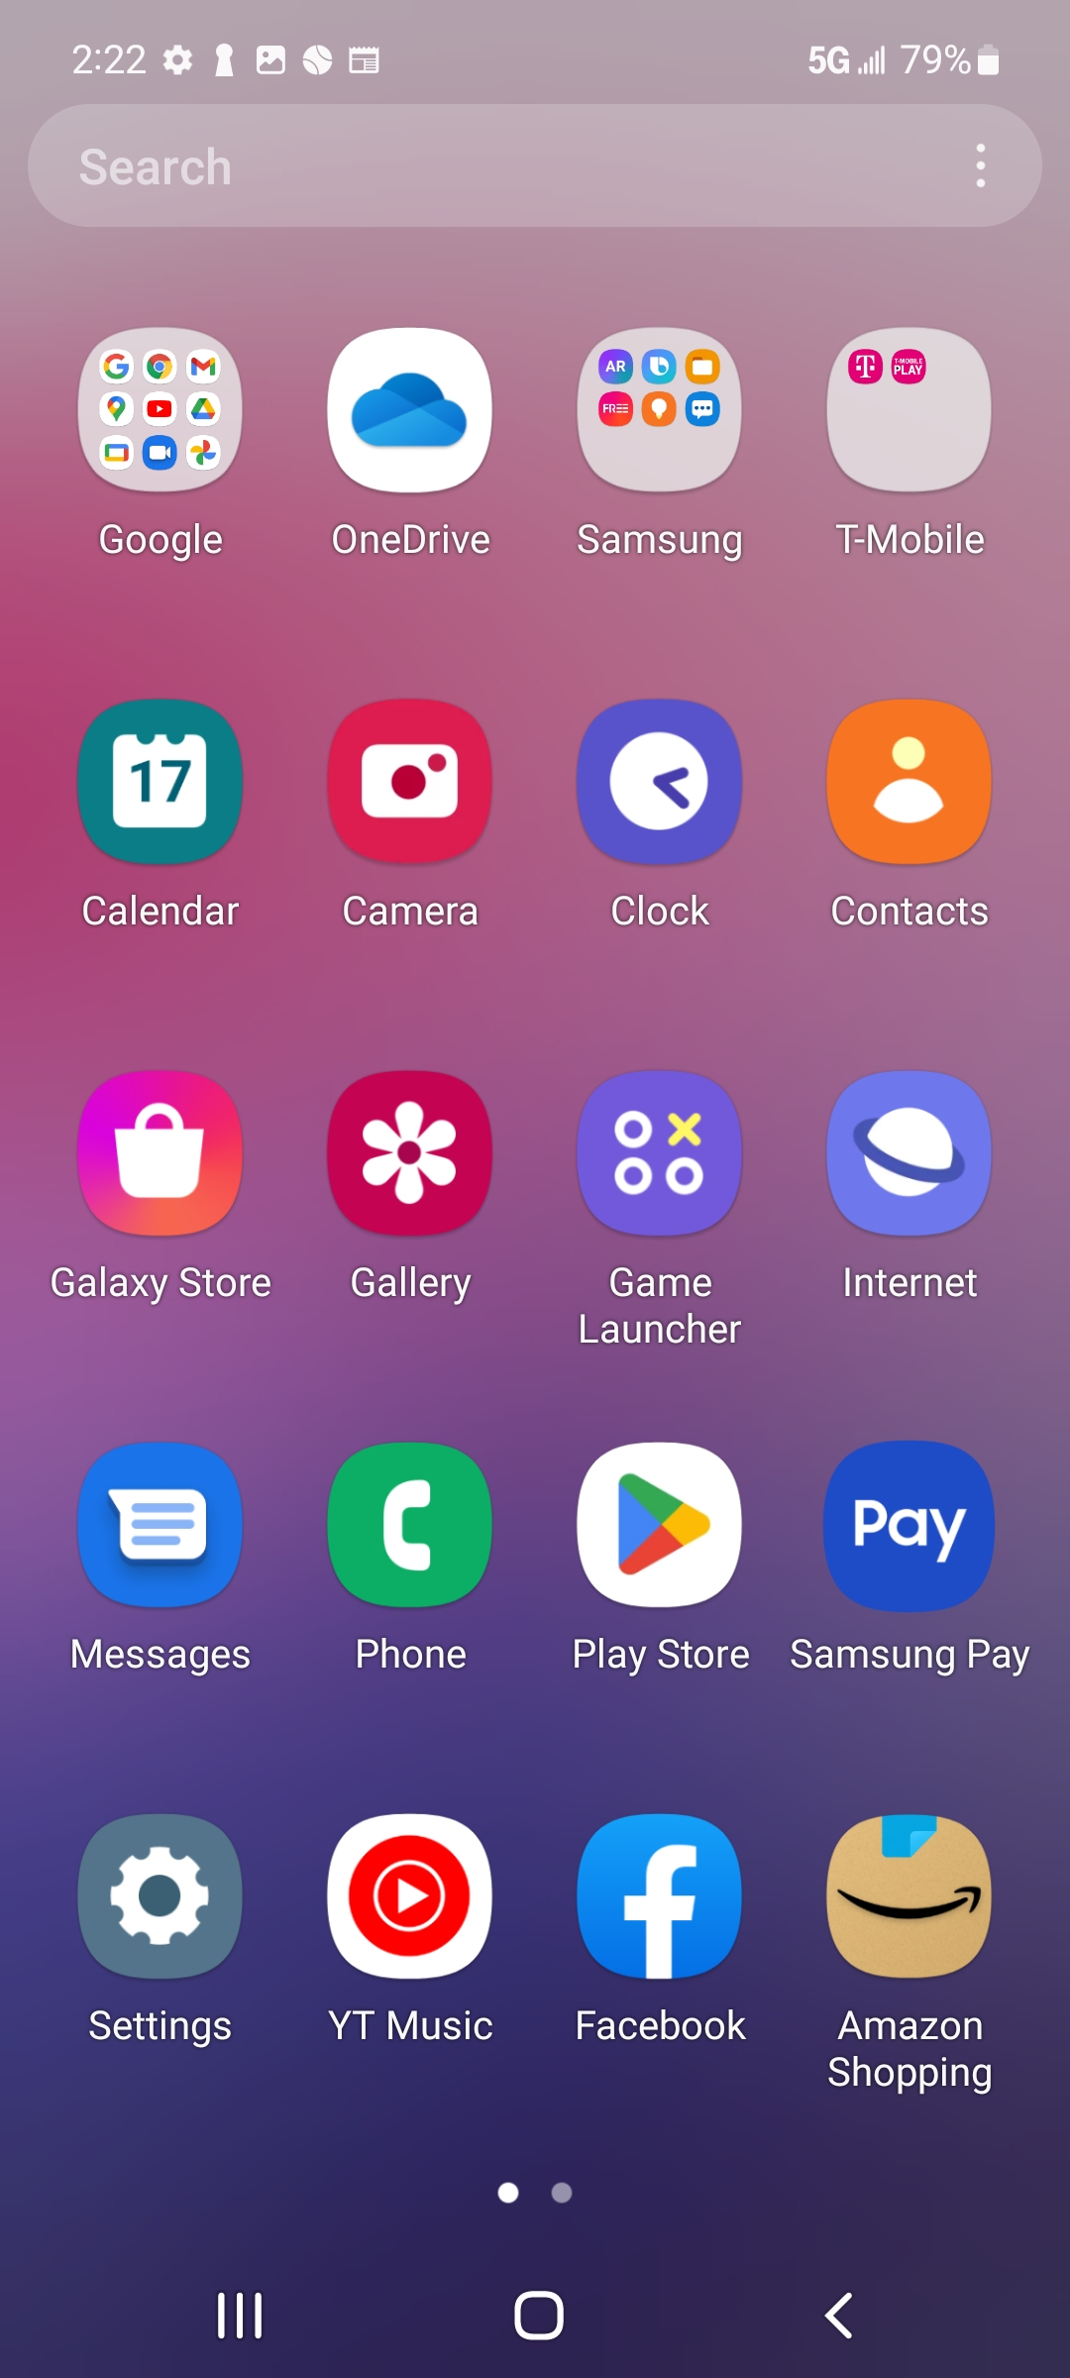
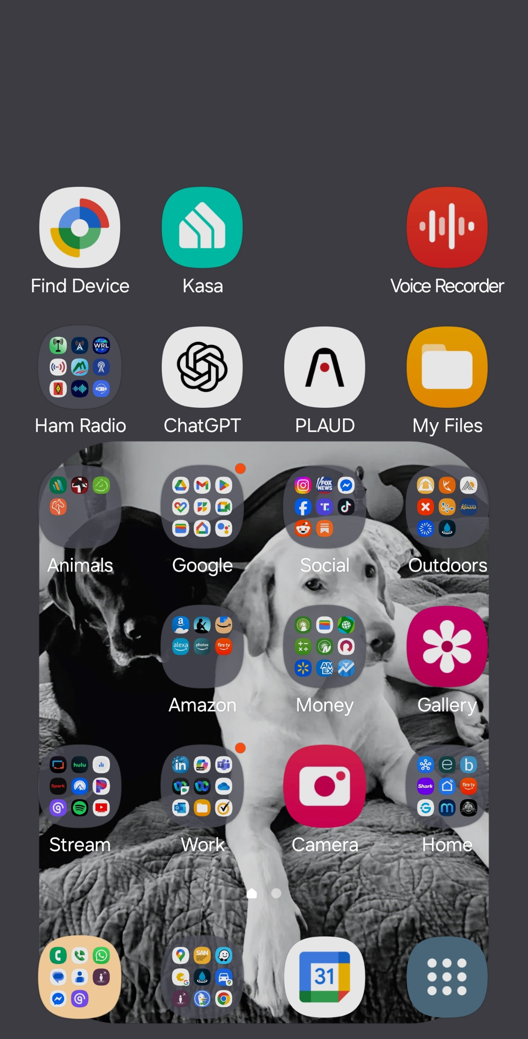
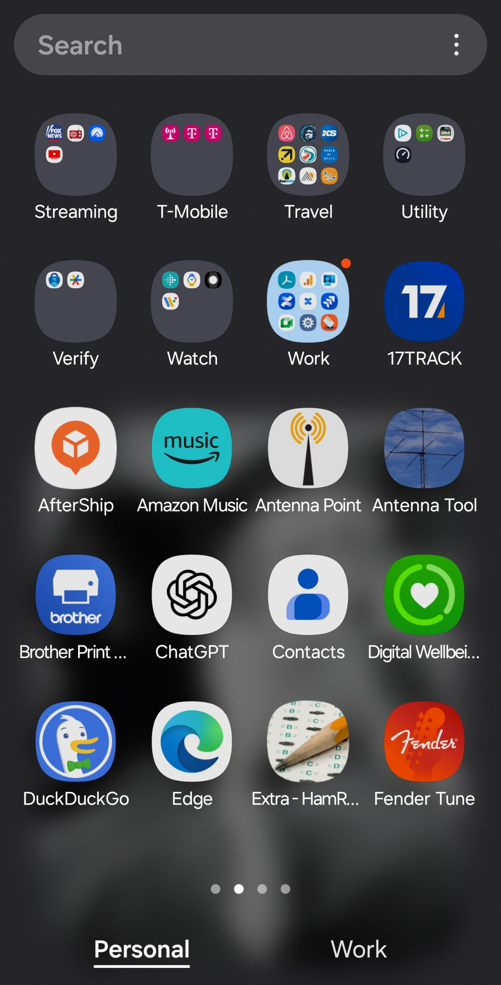
On-Device Custom AI User Experience Profiling – User Final Setup
Samsung
Final UX Setup
T-Mobile On Device Carrier Tools Client
AI Device UX Profile Changes

Slide 3
On-Device Custom AI User Experience Profiling – User Final Setup
Jake grab screen shots for these please
Apple
Final UX Setup
T-Mobile On Device Carrier Tools Client
AI Device UX Profile Changes

Slide 4
On-Device Custom AI User Experience Profiling – User Final Setup
Jake grab screen shots for these please
Moto
Final UX Setup
T-Mobile On Device Carrier Tools Client
AI Device UX Profile Changes

Slide 5
On-Device Custom AI User Experience Profiling – User Final Setup
Jake grab screen shots for these please
Tablet
Final UX Setup
T-Mobile On Device Carrier Tools Client
AI Device UX Profile Changes

Slide 6
On-Device Custom AI User Experience Profiling – User Final Setup
Jake grab screen shots for these please
Smart TV
Final UX Setup
T-Mobile On Device Carrier Tools Client
AI Device UX Profile Changes

